Slide 1
MICA
Music Identifying and Classifying Application
Group 6
Notes:
Before I get to the actual content of our project, consider following question. Have you ever heard some music that you are familiar but don’t know its name or can't remember it?

Slide 2
Motivation
Rapid growth on music
Unknown sources
Personal Interests
Notes:
And thats one of the motivation of this project.
Besides, the rapid growth on music has made music everywhere in people’s life. Such as internet, uni, or even when you walking on street, you hear melodies.
And Among these massive incoming music, a number of them are containing incomplete information, like the question stated before.
And at last, I, personally, and my teammates are fond of music.

Slide 3
Project Specification
Main focus: Classical Music
Instrument Retrieval
Music Retrieval
Notes:
This project delivers an integrated application of audios processing through uploaded files or recorded clips. Where the incoming audios are only focused on classical music
There are 2 major functionalities.
The first is Instrument Retrieval which means classifying instrument played in the incoming audio.
The second is Music Retrieval which is matching provided audio to our database and retrieve relevant information, like Shazam
In the next few slides, we will be spending some time to explain these 2 functionalities.

Slide 4
Instrument Retrieval
Our approach: MFCCs + Random Forest
Mel Frequency Cepstral Coefficients
MFCCs extracts representative instrument features from audio signal
Random Forest builds classifier based on the features
 | Accuracy | Precision | Recall | F-score
CNN | 82.74% | 0.7560 | 0.6888 | 0.7208
MFCC+Random Forest | 82.13% | 0.7908 | 0.5400 | 0.6418
MFCC+Logistic Regression | 81.80% | 0.7457 | 0.5857 | 0.6561
Predict Majority Class | 70.37% | 0.5001 | 0.4602 | 0.4793
Table from Automatic instrument recognition in polyphonic music using convolutional neural network.Peter Li, Jiyuan Qian, and TianWang. 2015.
Notes:
In order to solve the problem of instrument retrieval, we take the traditional path of machine learning by combining MFCC and Random Forest.
MFCC stands for Mel Frequency Cepstral Coefficients, which is a technique for extracting representative features from audio signal. In our case, we are extracting typical instrument timbres. Random Forest, on the other hand, is an ensemble learning method for classification using a multitude of decision trees. In this approach, the instrument features are used to build a classifier based on the technique stated here.
This idea is from a paper published last year. In the original paper, the focus is not actually MFCC+Random Forest but Convolutional Neural network. Which in fact was our first choice for this project, however, we gave it up due to some limitations we were having which I’ll talk about it at the end of the presentation. Now back to the table here, because CNN is kind of inapplicable, MFCC with random forest became our rightful choice at the end.
Next, Kevin will talk about Music Retrieval bit followed by the storyboard of our application

Slide 5
Music Retrieval
Searching music stored in the database
File(Import wave, sndhdr library)
Built-in Microphone(Recording: Pyaudio, Pygame threads)
Our approach: Audio Fingerprinting
Fingerprint: condensed digital summary, which is deterministically generated from audio signal
Used by Midomi(SoundHound), Shazam¹
Analyse and Store Fingerprints in Mysql database(Dejavu library)
Further compare Fingerprints(File and database)
Music player functionality with file and database music
¹ Wang, A. (2003, October). An Industrial Strength Audio Search Algorithm. InISMIR (pp. 7-13).
Notes:
Music Retrieval is also a main feature in our application. It mainly does the searching functionality of the music stored in the database.
We provide two ways of searching the music, search with a file and search by recording with built-in microphone.
We used python and import the wave and sound hdr library that has already included in python to check and read the music with file.
We also used Pyaudio library and Pygame threads to handle the recording and searching session.
From the technical perspective, we used Audio fingerprinting to solve the retrieval problem. Fingerprint is the condensed digital summary, which is deterministically generated from audio signal. It has been proven by the industry and is widely used for lots of famous apps for example Midomi(SoundHound) and Shazam. In our approach, Firstly, we analyse and store the fingerprints with using the Dejavu library in Mysql, and further compare the fingerprints of the
readed or recorded file, with all the fingerprints stored in the database.

Slide 6

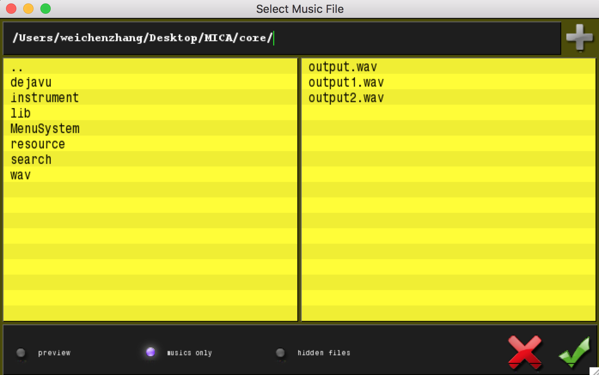
Feature Instruction(Storyboard)
1. Main Page. 2. File Dialog(Select File)
Notes:
First one is the main page which is included the Instrument, search and similarity functionalities of our system MICA.
Second is the file dialog that popped up when user select the music file. (music only option use the sndhdr library to check)

Slide 7
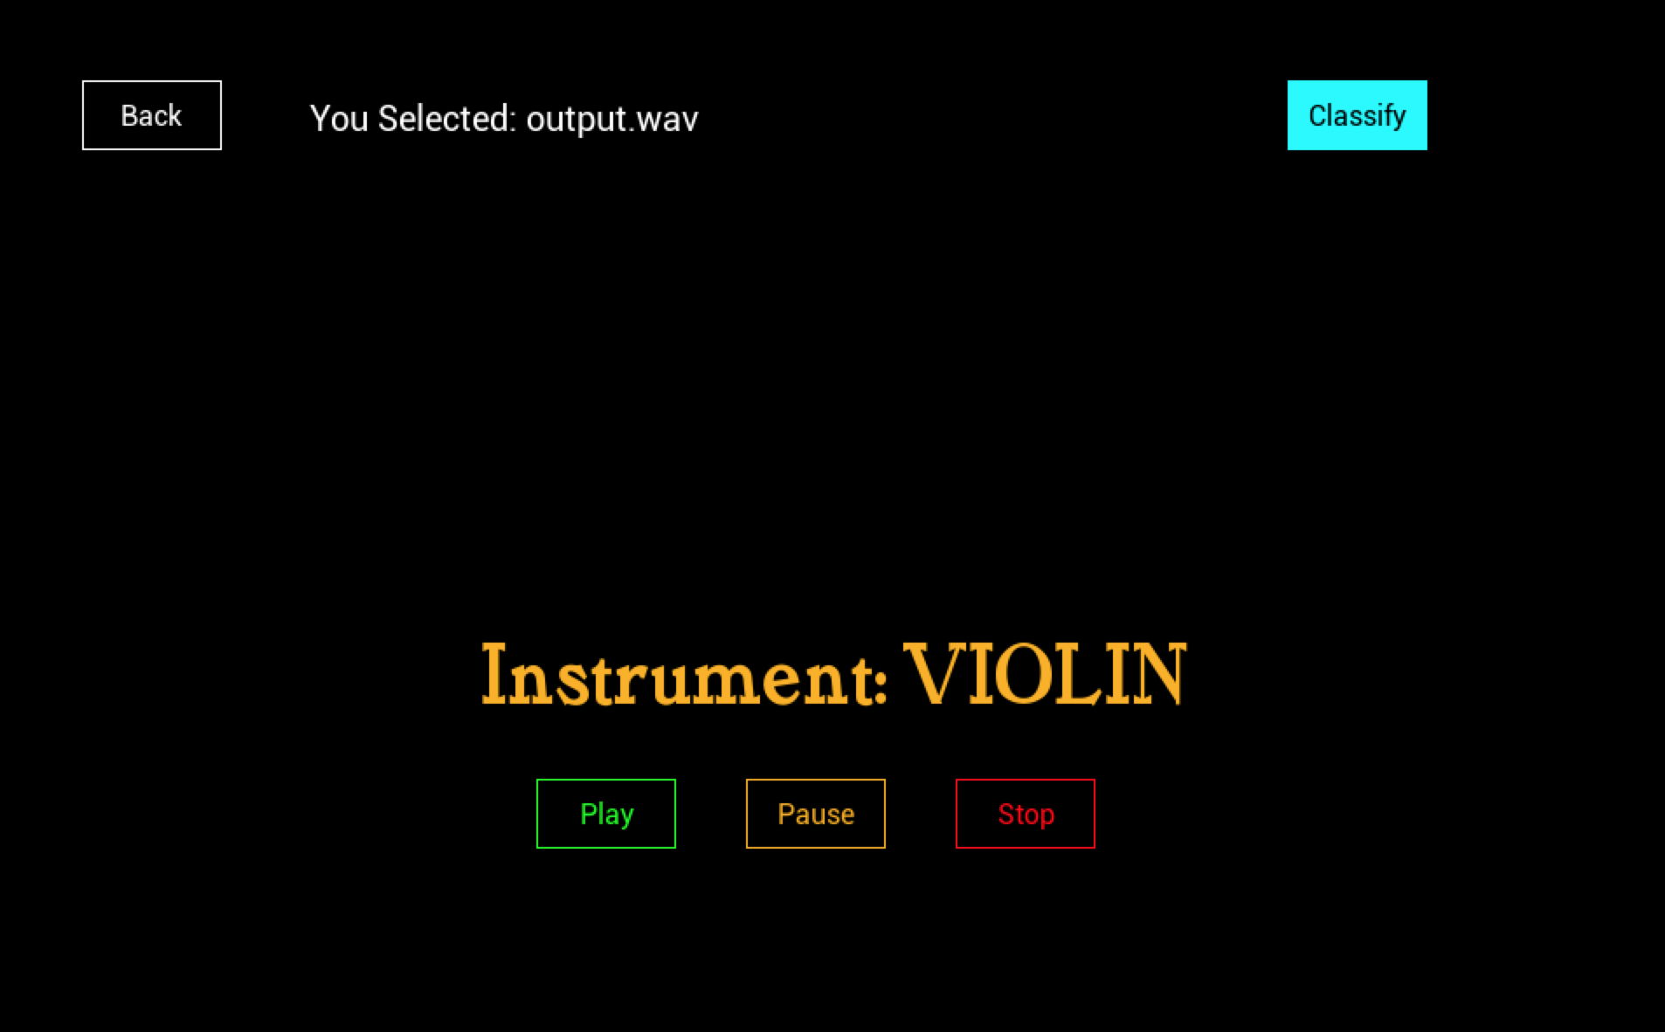
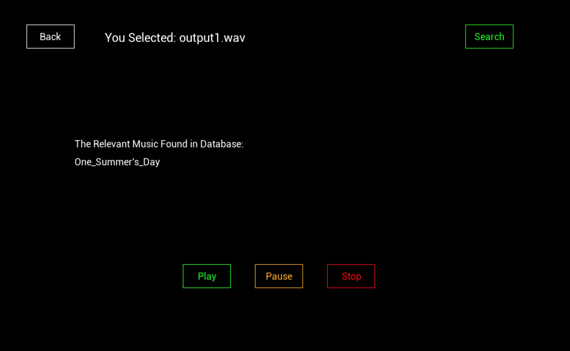
Feature Instruction(Storyboard)
3. File Instrument Classification 4. Select audio and Search

Slide 8
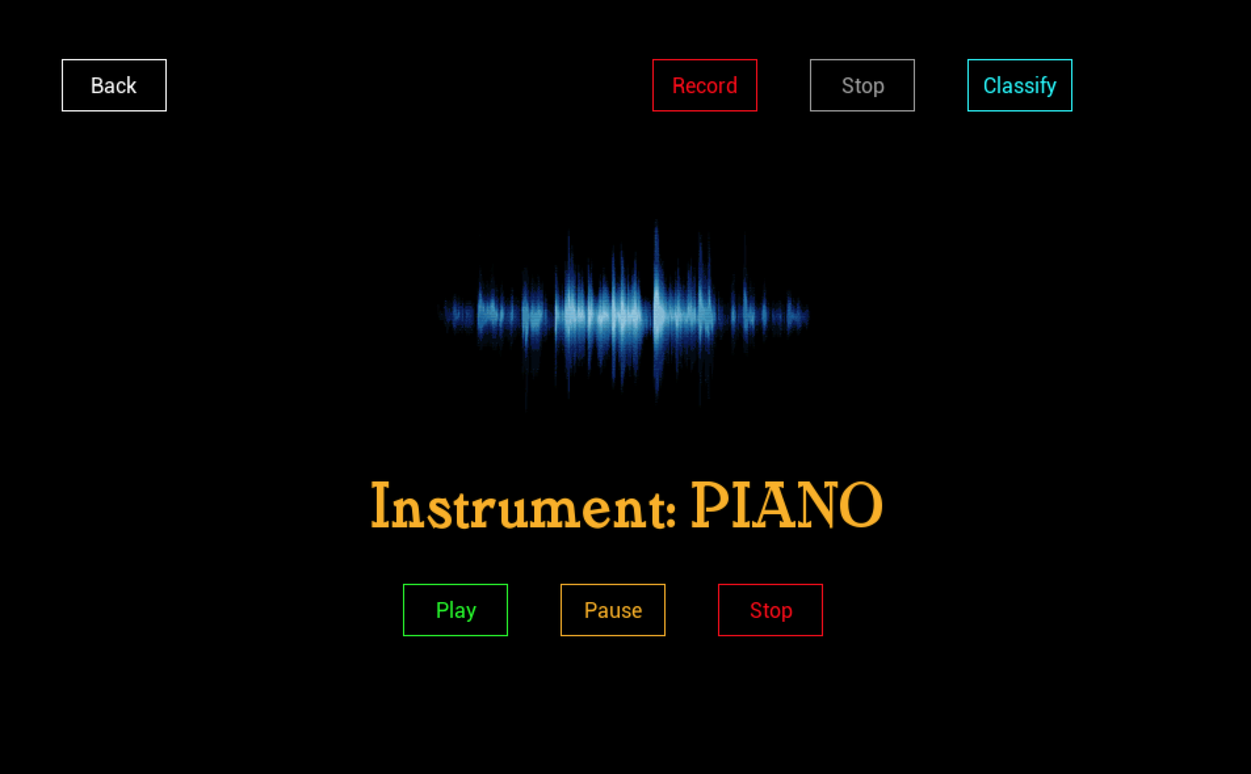
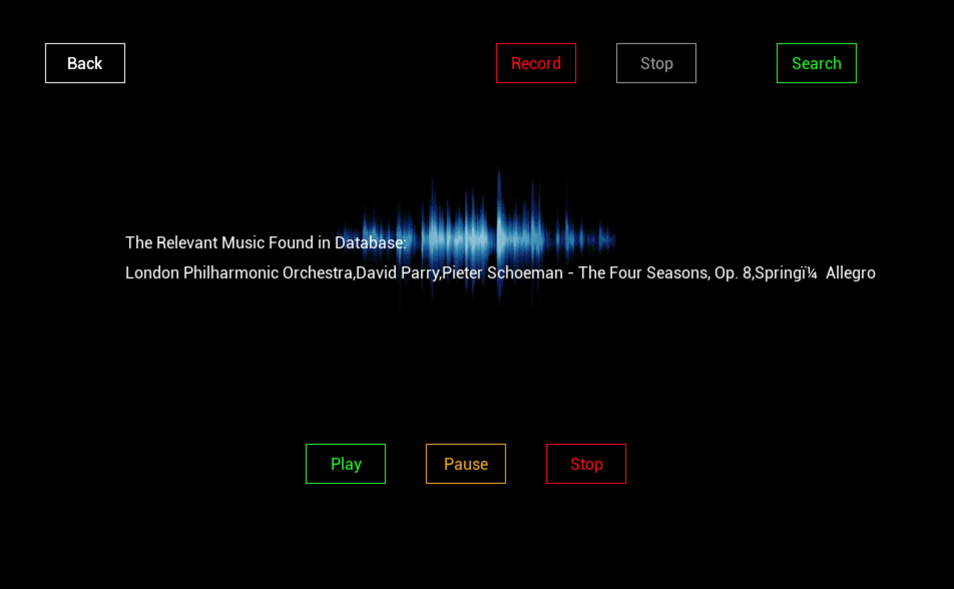
Feature Instruction(Storyboard)
5. Record and Classify Instruments 6. Record and Search Relevant Music

Slide 9
Limitation and Future Work
Small size of dataset
Convolutional Neural Network
Extend the functionalities
Notes:
The significant limitation in this project is the extremely small size of dataset we are having. Because there are very few existing dataset for classical music and we were collecting the data on our own. We collected for like 30 to 40 songs at the end. And this is the biggest problem for using a CNN technique, because CNN requires a huge number of training data before you can achieve a reasonable accuracy.
Therefore, next step or future work in this project is to collecting more data for Convolutional Neural network which is a finer pathway for classification. Moreover, current functionalities can be extended to multiple kinds of music other than classical music.

